Slide 1
Predicting player position
USING MACHINE LEARNING

Slide 2
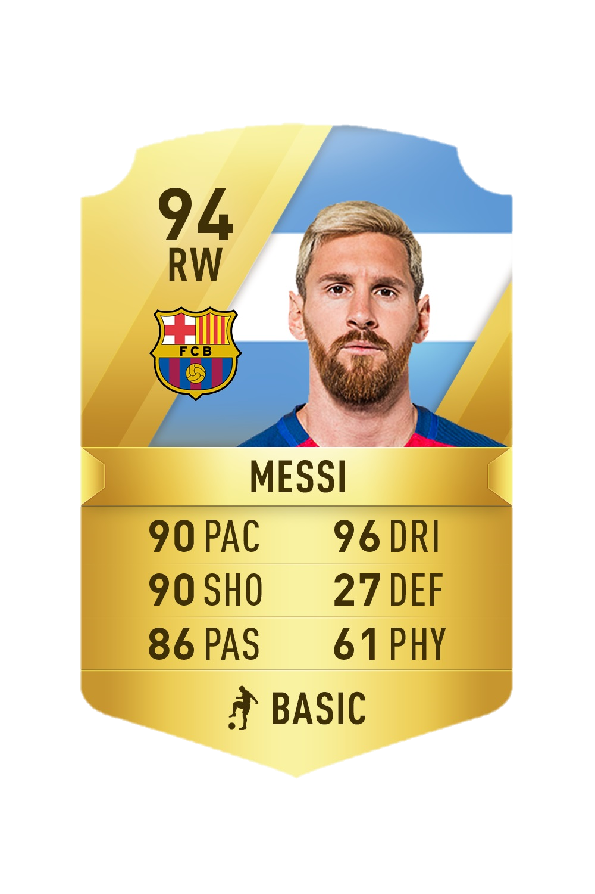
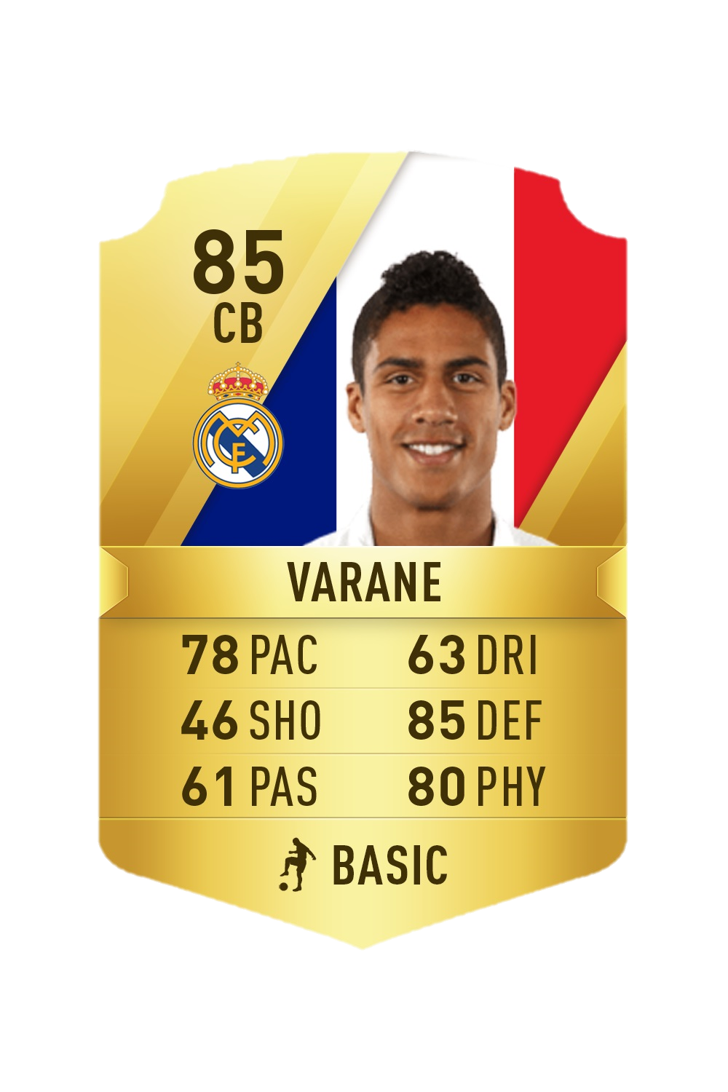
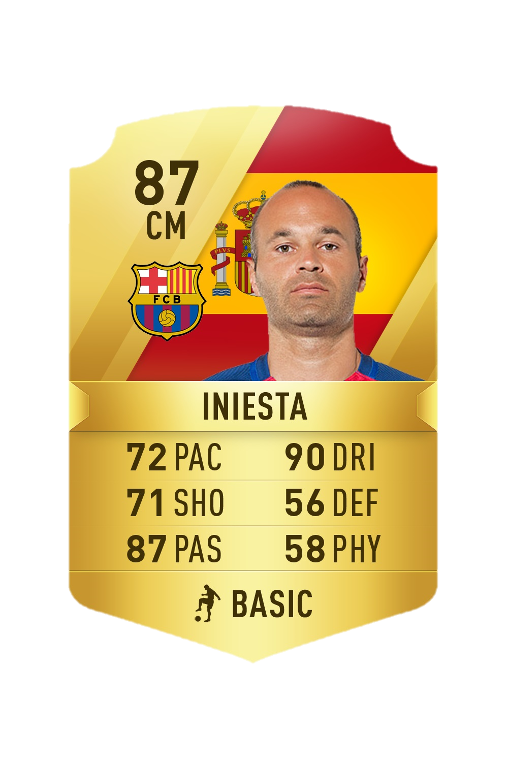
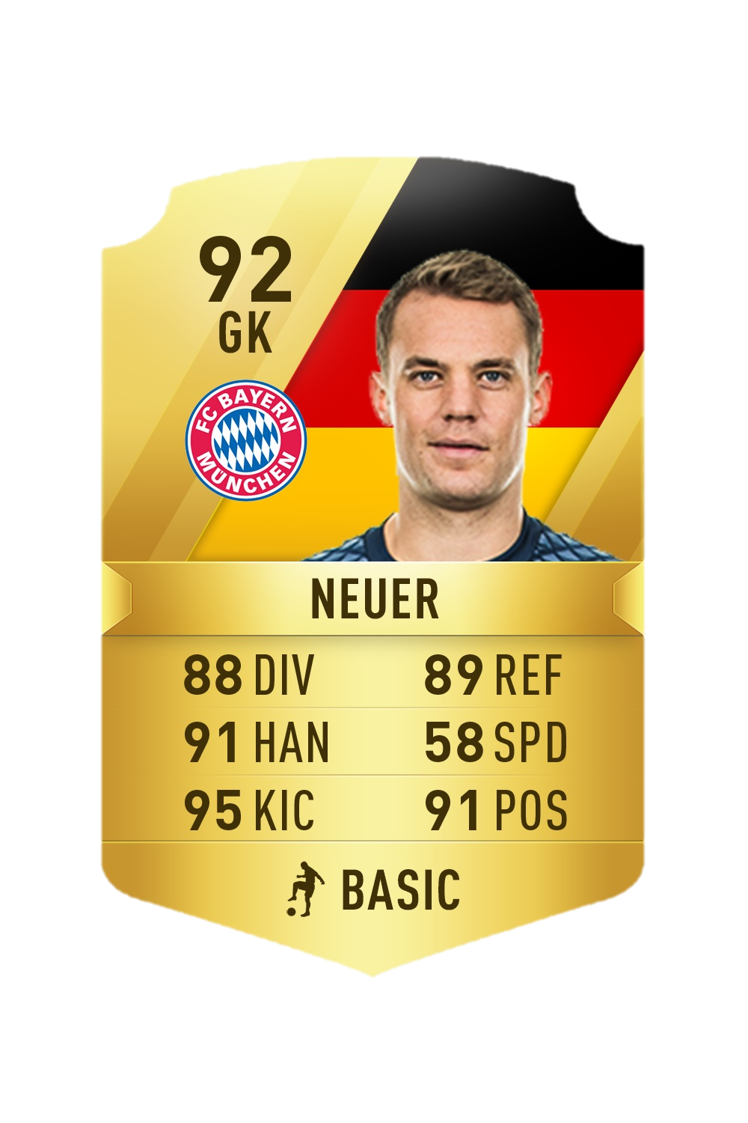
the Data
EA Sports’ FIFA-2018 in-game statistics
Statistics from player cards
Each player has a skill rating in every category
All skills are rated between 0-100.
Goalkeepers have a different set of skills.
All stats are created with the help of scouts, coaches and team of data-scientist.
We aim to predict the position of the players by training our algorithm.
A similar model can be implemented in other fields to gain similar insight.
Notes:
Next, I will like to brief you about the data we have used here. Many of you guys must be familiar with the EA sports game FIFA, we have used the player stats from the game. Each player here has a play card which has his detailed stats, something like this( show cards) so we have passing accuracy, dribbling, shooting and so on.
· EA dedicates a lot of resources and research to be as precise as they can be in these stats, so we know that the data we have is the best we can have. We have stats for over 18 K players in 75 categories and we use these to check if we can predict the position the player plays and to what accuracy.
· We believe that a similar model can also be implemented in other fields if successful. We will get to that in a few moments.

Slide 3
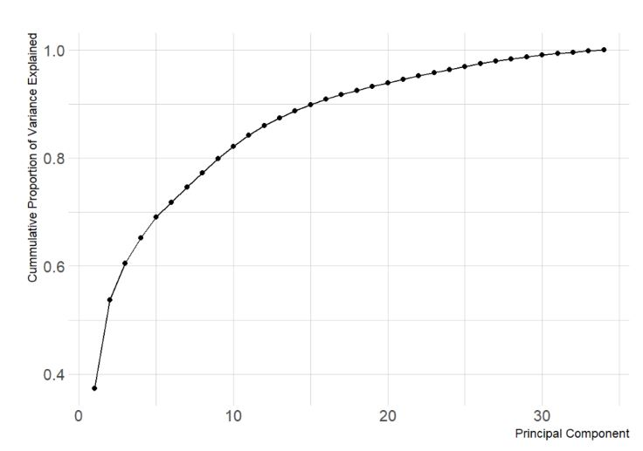
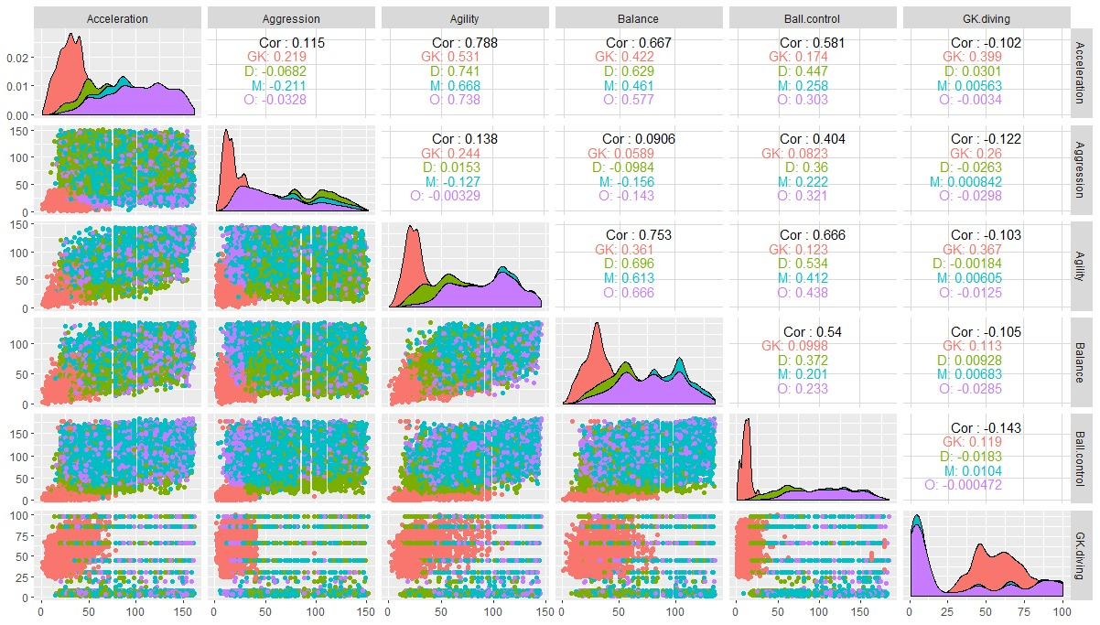
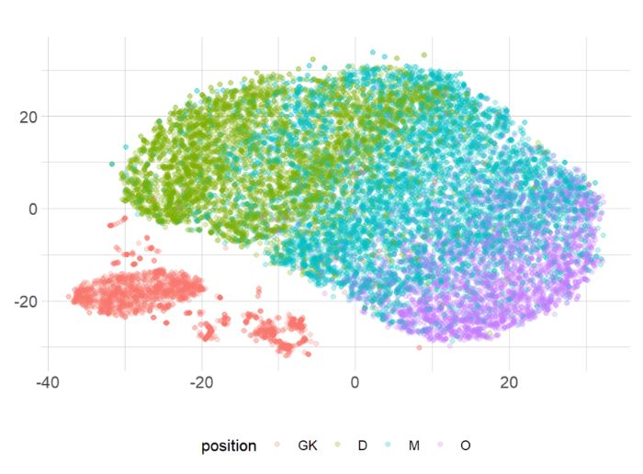
Pre processing
We have 75 categories of statistics, of which we select 34
We group the according to their positions
Overview the data, find trends in it using scatterplots
Use PCA and tSNE
The graph show distinct separation between positions.
Other techniques show similar results.
We get enough from these graphs to carry on with our analysis and move to the next step which is Machine Learning
18,000 players
Offense
Midfield
Defense
Goalkeeper
Notes:
As we saw we have 75 categories for each player, but some of them are not useful to us like players name, his country of origin and so on, so we drop some of the variables and will consider 34 attributes, one of which was positions. So we grouped them together, all offensive defensive and midfield players were grouped accordingly, also goal keepers had a group of their own.
· Next, we tried to study the trends in the 34 categories using the scatterplots for all 34 stats, which was a mistake because we had to study more than 500 of them making the process very cumbersome, so we opted to go a better route by using PCA and tSNE.
· The principal components will capture the variance in the data set. The first principal component captures the highest amount of variability. The larger this variability is, the more information is contained in it as we see in the graph.
· We also used tSNE i.e. t-distributed stochastic neighbor embedding, what it does is identify patterns in data.
· So here we can see that their is distinct separation in the clusters between the roles, we have GK really all on their own and defensive and offensive players are easily distinguished. The midfielders are right where they are supposed to be i.e. in the middle.
· We also used a few other techniques but got the similar observations everywhere else.
· Once we had these results, we learned that it was possible to distinguish positions of players by player attributes and a more accurate prediction could be made using machine learning.

Slide 4
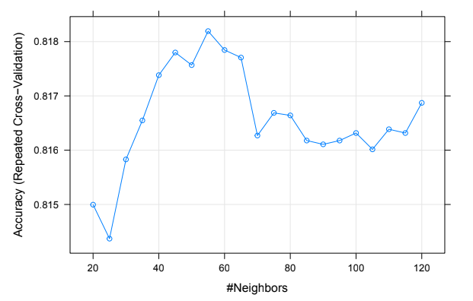
The kNN MODEL
Before implementation
We split the data
Validate the data
Implement kNN
We used values for k from 20 to 120
k=55 gave us the highest accuracy
We get model with 81.82% accuracy
We see clear classification for Goalkeepers
Offensive, Defensive and Midfield players are also quite accurately classified
Position | GK | D | M | O
Training set | 0.11 | 0.3 | 0.4 | 0.19
Test set | 0.11 | 0.3 | 0.4 | 0.19
 | GK | D | M | O
GK | 399 | 0 | 0 | 0
D | 6 | 918 | 167 | 6
M | 0 | 169 | 1169 | 216
O | 0 | 1 | 98 | 445

Slide 5
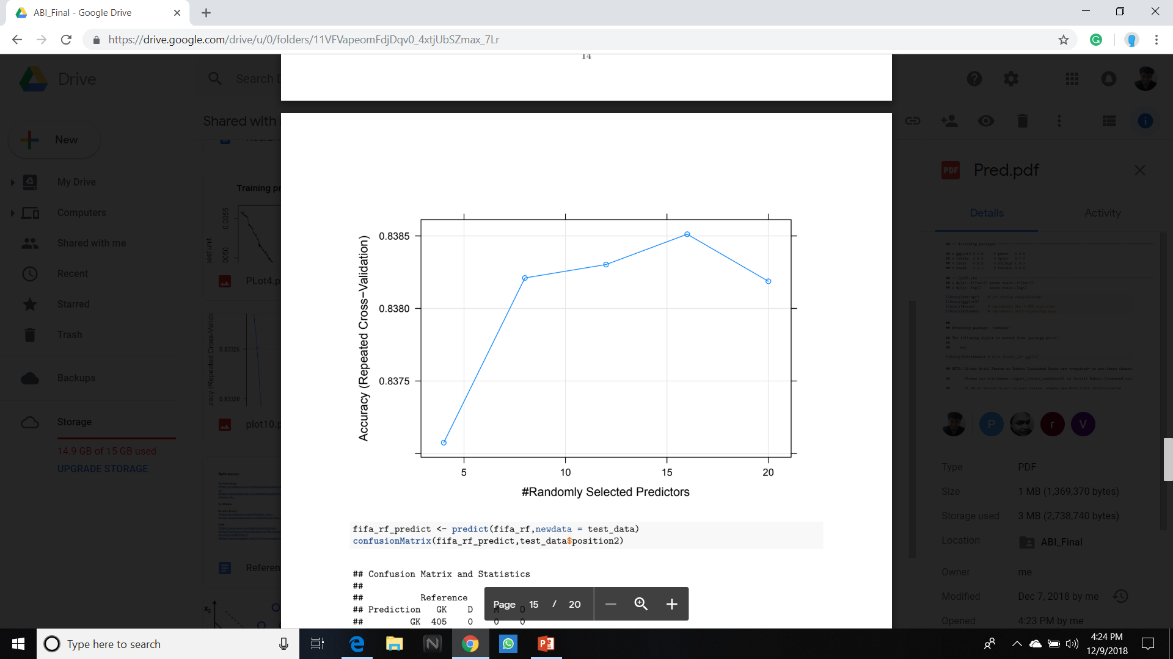
Random forest Model
Advantage of using random forest
Lower risk of overfitting
Better predictive power
Select the best split
Test using confusion matrix
Performs better than kNN
Predicts Goalkeepers correctly
Better prediction for Offense and Defensive players
Mid field positions saw some decrease
 | GK | D | M | O
GK | 405 | 0 | 0 | 0
D | 0 | 955 | 162 | 7
M | 0 | 131 | 1154 | 192
O | 0 | 2 | 118 | 468

Slide 6
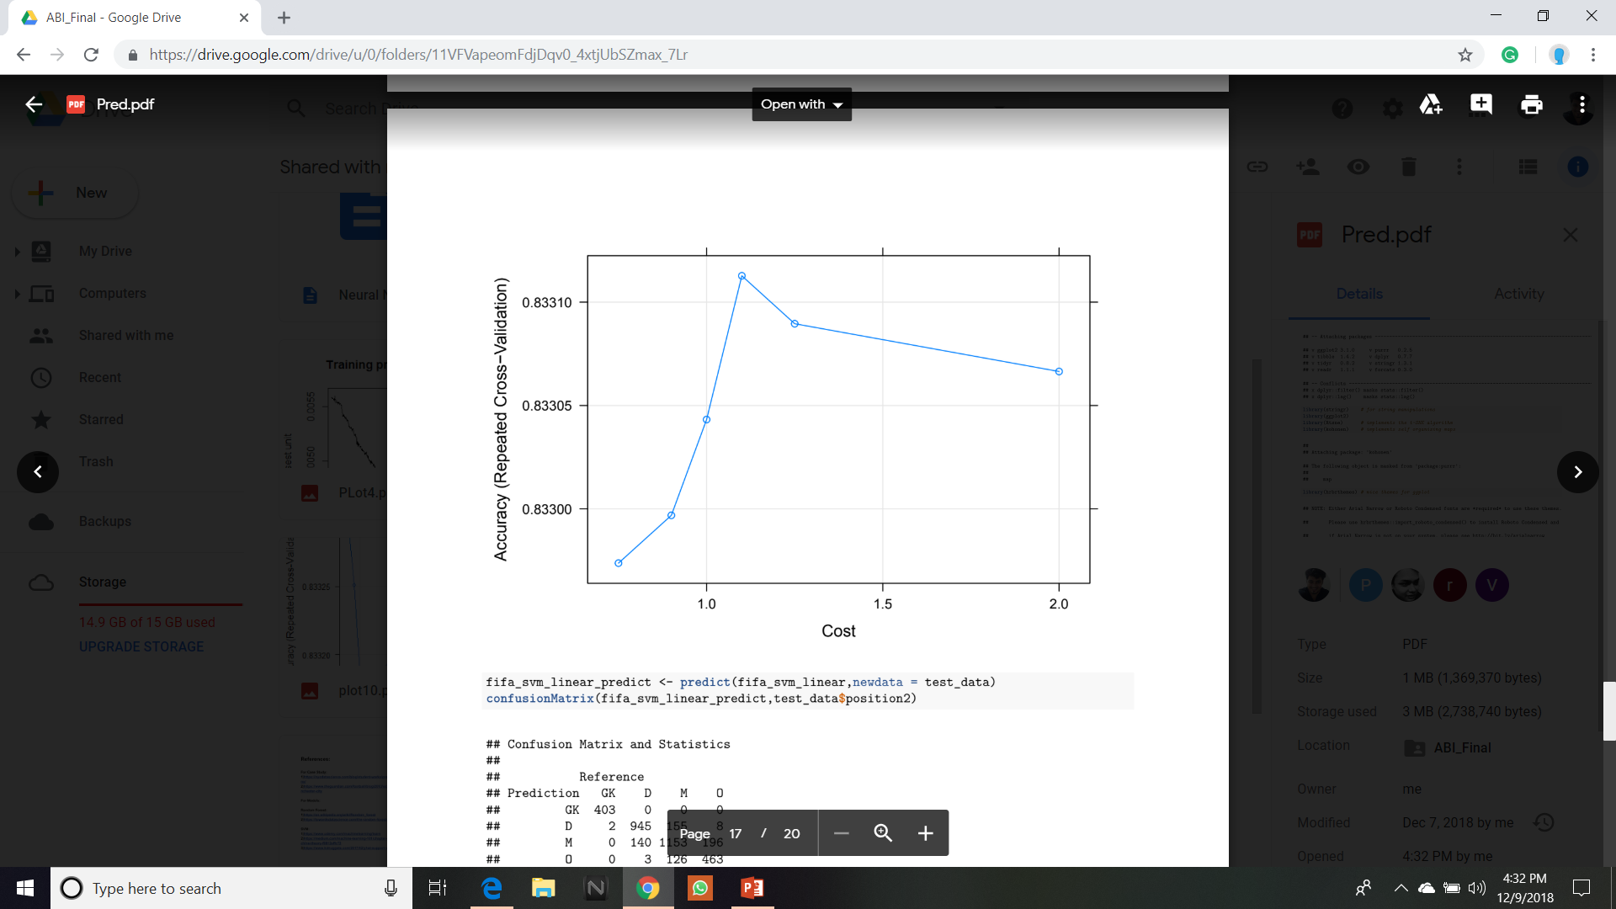
Support vector machine model
We use SVM with non-linear kernel
Decide the cost parameter
We take cost function 0.75, 0.9, 1, 1.1, 1.25 & 2
1.1 has the highest accuracy
Predict and calculate accuracy
We get results similar to earlier model
A slight decrease in Defenders and slight increase in Midfielders
 | GK | D | M | O
GK | 403 | 0 | 0 | 0
D | 0 | 945 | 155 | 8
M | 0 | 140 | 1153 | 196
O | 0 | 3 | 126 | 463

Slide 7
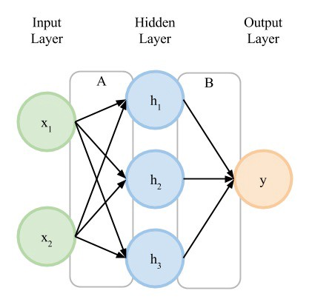

NEURAL NETWORK
“A computer system modelled on the human brain where highly interconnected elements
process information by their dynamic state response to external inputs”
Organized in layers of interconnected 'nodes' containing 'activation function’
Has Black Box Configuration for performing Iterations & check Desired Error Level
Randomly assign weights to connectors and bias to nodes
Nodes Value: h1 =(x1*weight1+x2*weight2)+bias1
Uses 'learning rule' to modify weights of connections according to input patterns
Inputs through a random rate which gets more accurate over time
Does ‘Backpropagation’ of error to adjust weights and biases
Once done, we test input to get good guesstimation of outputs
Notes:
A computer system modeled on the human brain where highly interconnected elements process information by their dynamic state response to external inputs
Neural neworks are typically organized in layers. Layers are made up of a number of interconnected 'nodes' which contain an 'activation function'.
Patterns are presented to the network via the 'input layer', which communicates to one or more 'hidden layers' where the actual processing is done via a system of weighted 'connections'.
The hidden layers then link to an 'output layer' where the answer is output as shown in the graphic below.
We initialize the network with a bunch of completely random weights and biases From there, we start with first entry in our dataset
We start moving input dimensions through the neural network(its called feed forward neural network)
It has Black Box Configuration(Tuning) Options
How many hidden layers? usually 1
How many nodes in each hidden layer?
Then we see
How many times it goes over all the data in your dataset
How accurate you want this thing to be
This is called Iterations & Desired Error Level
(training stops when you reach one or the other)
Start with Random guess
Node1:(InputDim1*weight1+InputDim2*weight2)+Bias1
Most ANNs contain some form of 'learning rule' which modifies the weights of the connections according to the input patterns that it is presented with.
In a sense, ANNs learn by example as do their biological counterparts;
We give inputs through a random rate which gets more accurate over time
Biases, activation function, calculate error and backpropagate some adjustments to the weights and biases.
Once done, we get a set of weights and biases that are accurate.
Then we test input ot get good guesstimation of outputs.

Slide 8
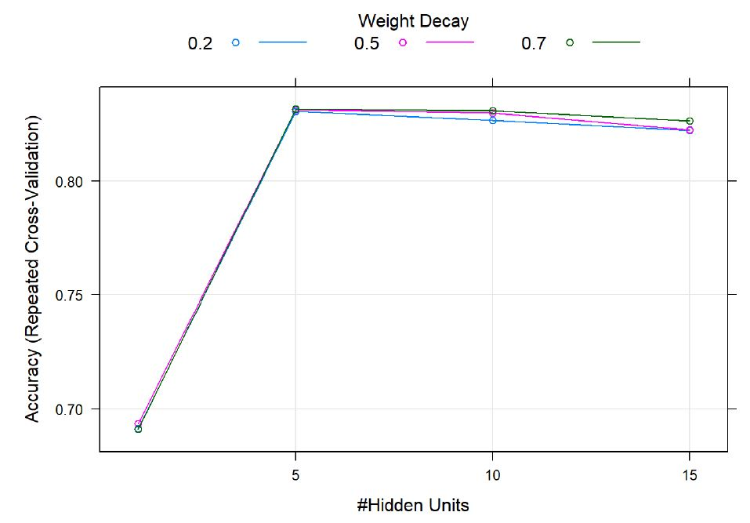
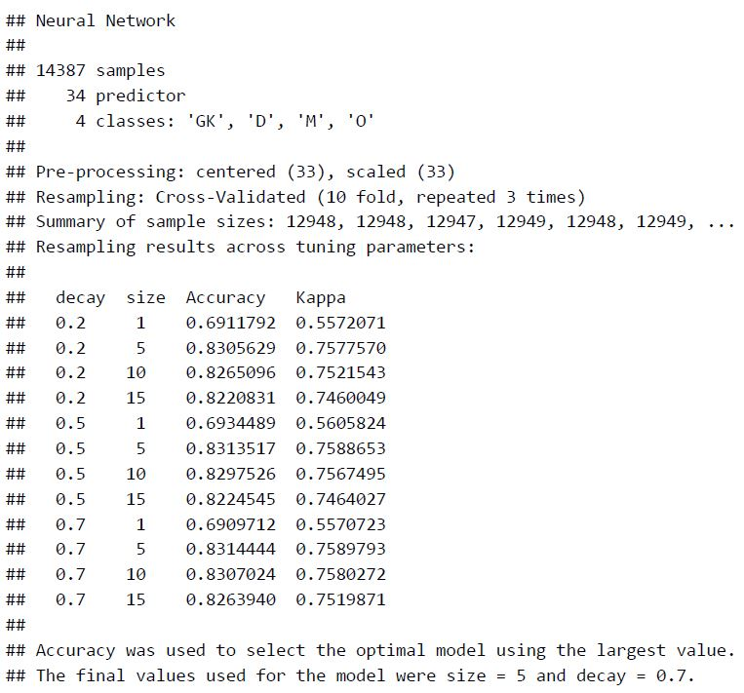
PREDICTIONS WITH NEURAL NETWORK
Use “Repeatedcv” Resampling with 10-fold cross-validation repeated 3 times.
Specify Hyper-Parameters for tuning:
Size = (1, 5, 10, 15)
Decay =(.2, .5, .7)
Train Neural Network using tuning and control parameters
Select Optimal Model with Highest Accuracy and Kappa
Final/Best values for model were:
Size = 5
Decay = 0.7
Notes:
Now we will fit a neural network model in R using 'caret' package
To modify the resampling method, a trainControl function is used.
Method used here is"repeatedcv", which specifies repeated K-fold cross-validation, dividing the to train and test data in random way.
We set the number of repetitions to 3 while the value of K is defaulted to 10.
To define tuning parameters
We create a data frame of cartesian products using 'expand.grid' function in R, wherein we specify our hyper-parameters:
Size is the number of units in hidden layer taken to be 1,5,10,15
and Decay is the regularization parameter taken to be .2, .5 and .7
Now we train our neural network using tuning and control parameters that we just defined.
setting maximum iterations to be 500 and absolute tolerance of 0.01
Accuracy was used to select the optimal model using the largest value.
The final values used for the model were size = 5 and decay = 0.7

Slide 9
Conclusions
1
2
3
4
5
 | kNN | RF | SVM | N-Net
Accuracy | 0.8155 | 0.8297 | 0.8247 | 0.8216
Kappa | 0.7343 | 0.7561 | 0.7488 | 0.7448

Slide 10
Future Use
1
2
3
4
5
Thakyou !

